Slide 1
BIRDHUB
IOT 2021/2022
Group 09

Slide 2
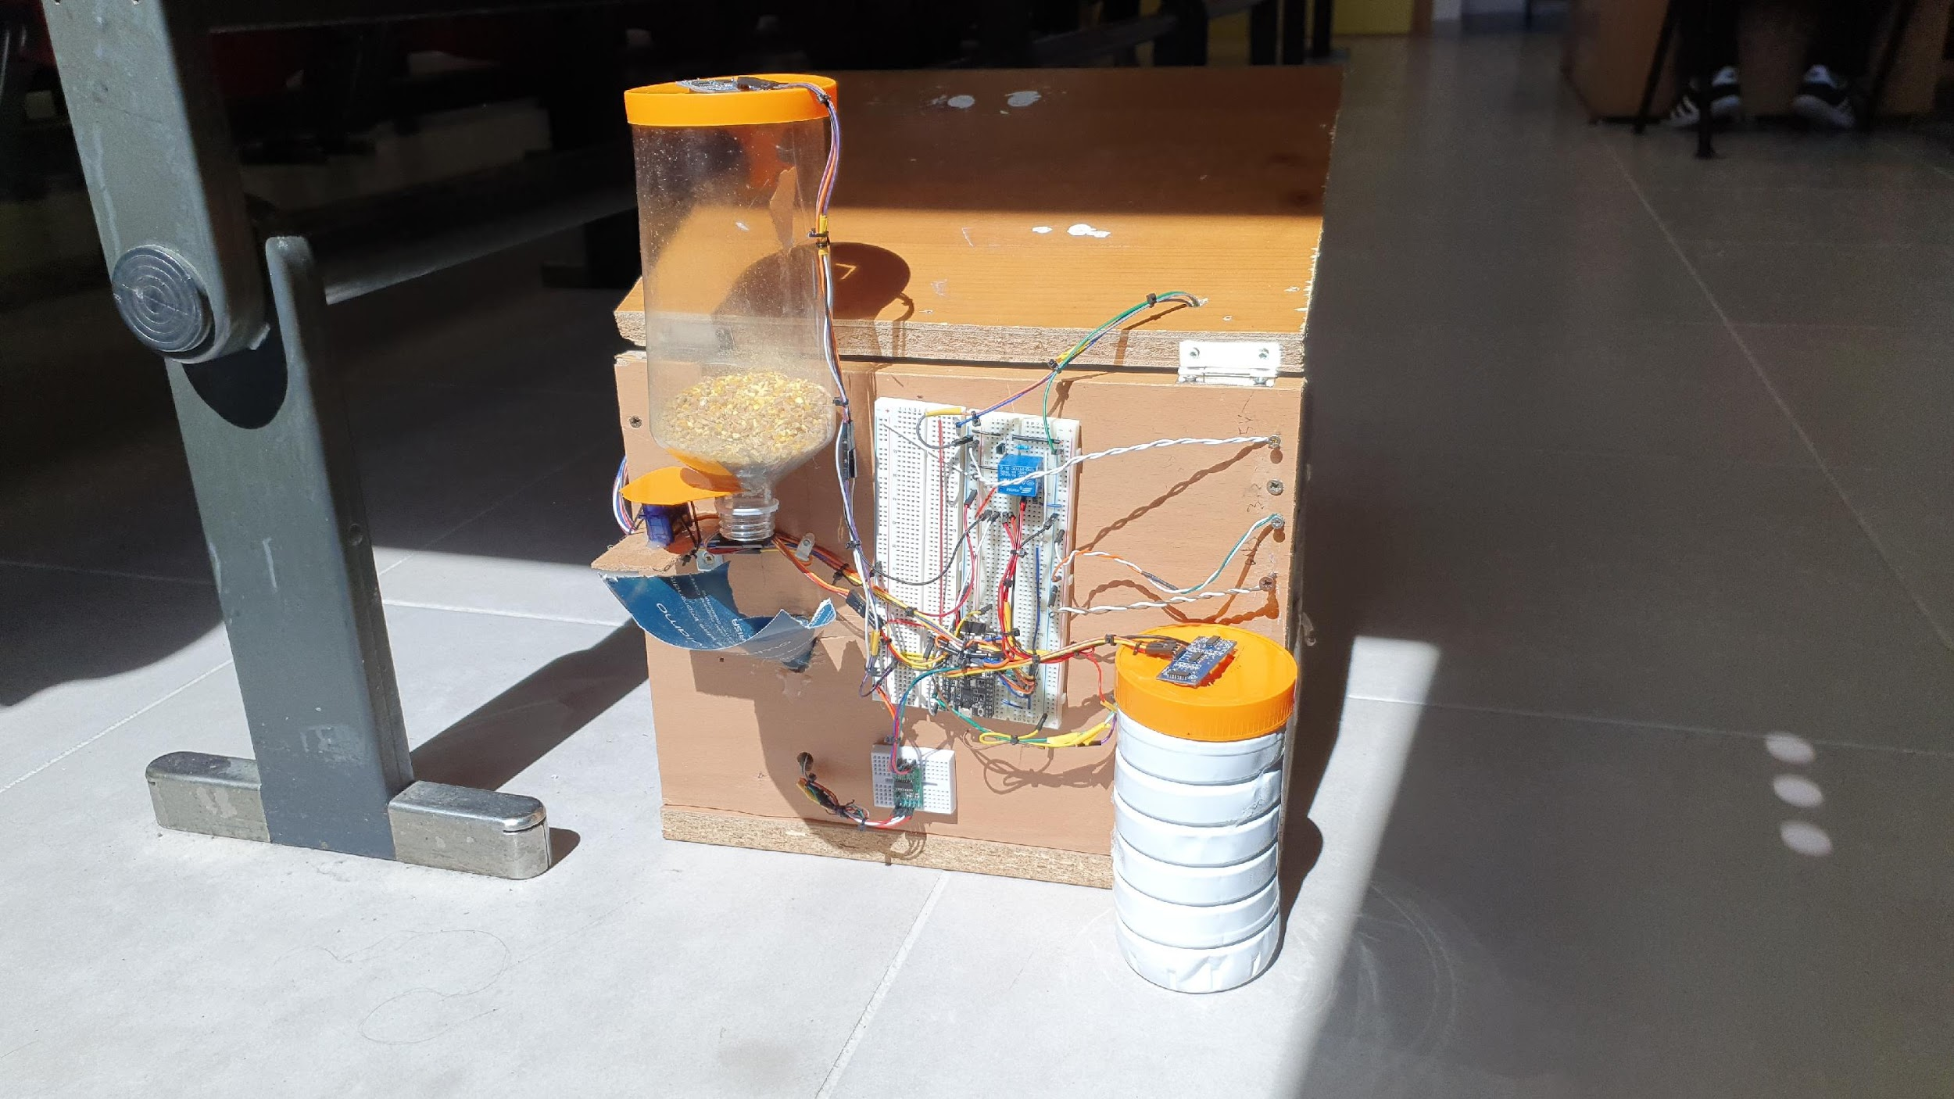
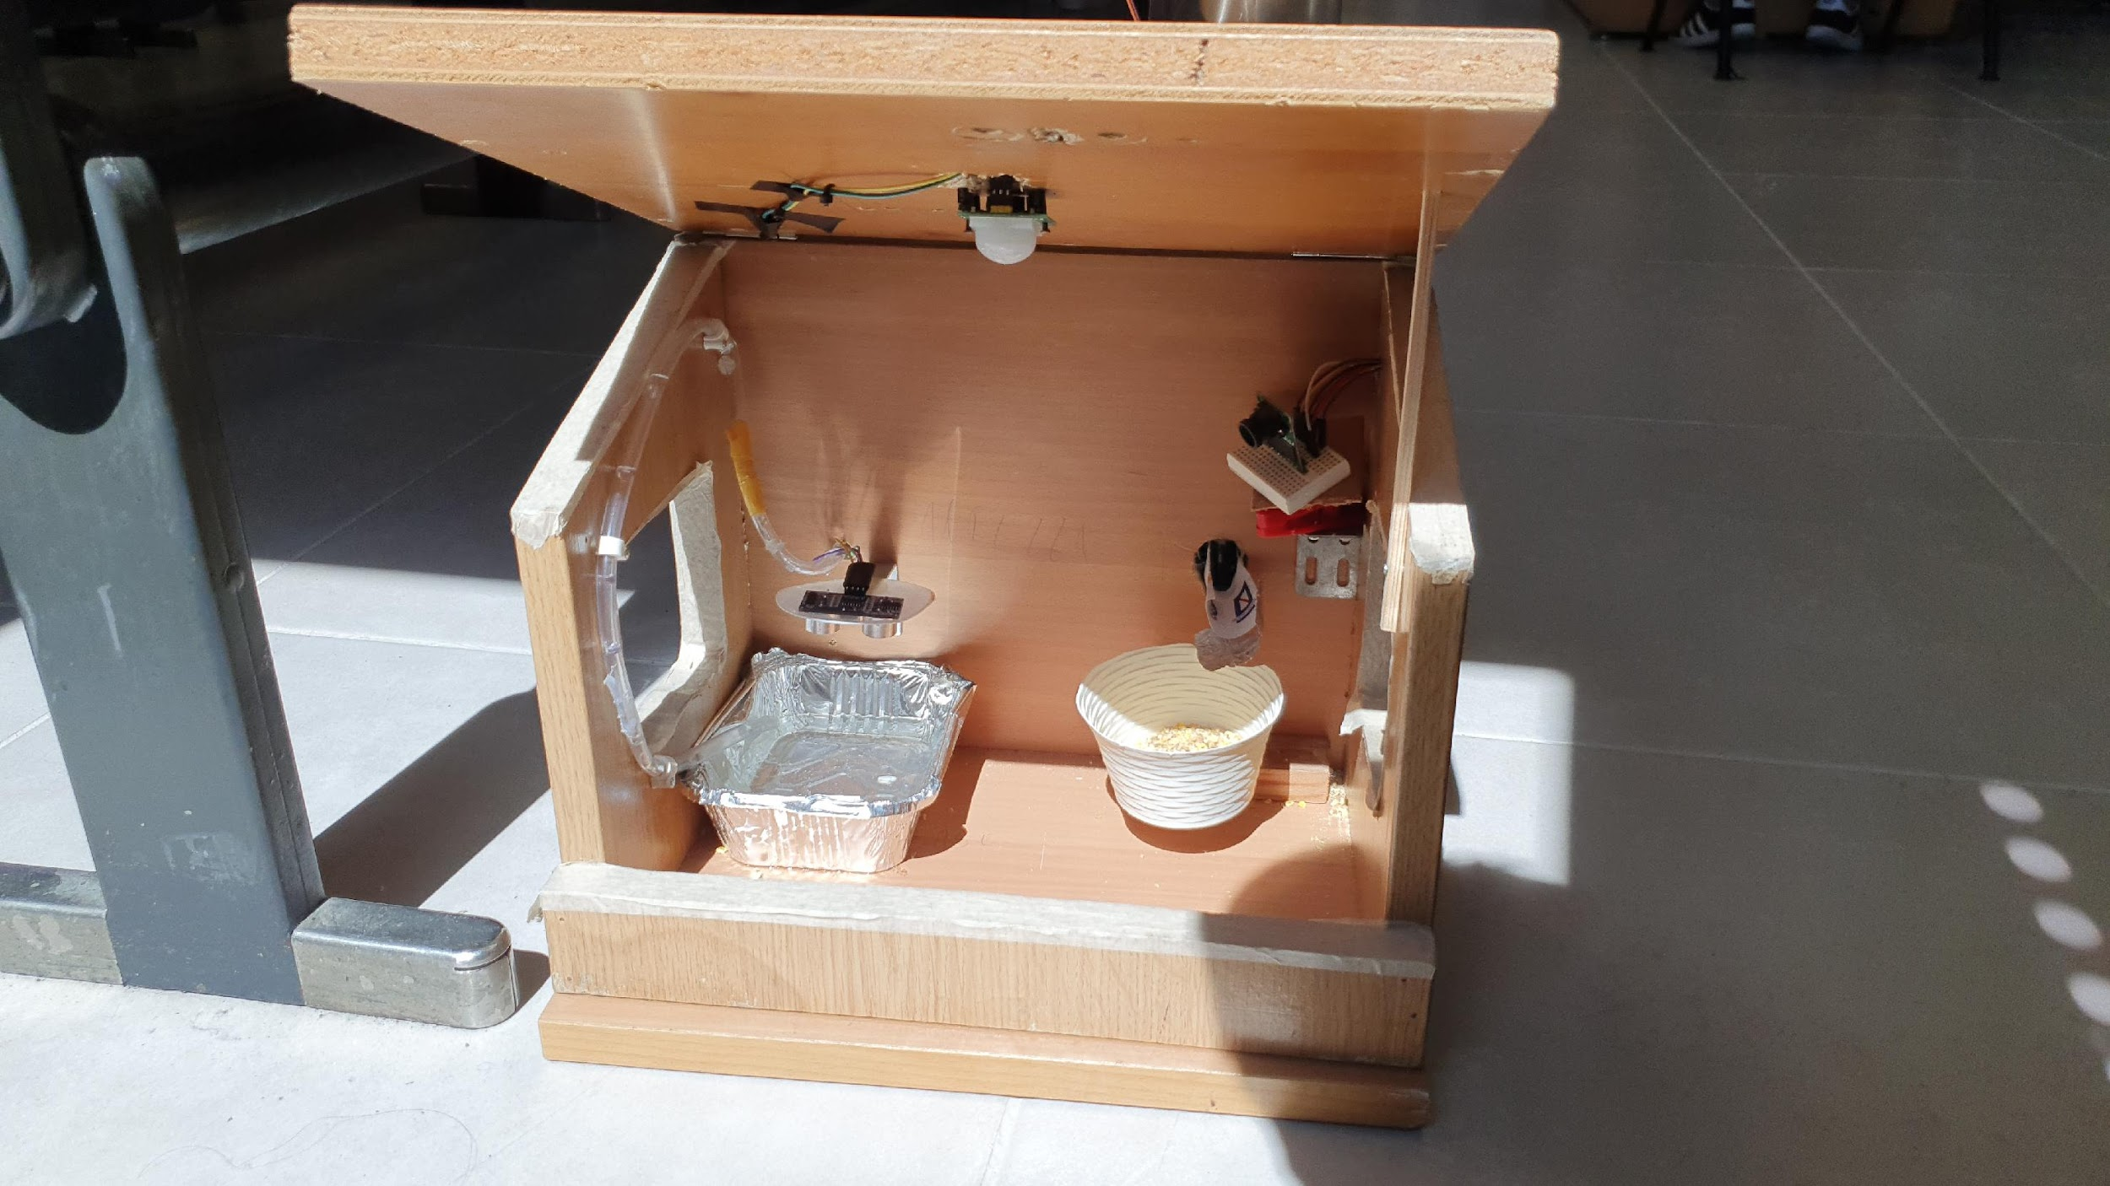
BIRDHUB

Slide 3
PROJECT OVERVIEW
Bird detection
Food supply
When a bird enters the hub, a picture is taken and an alert is sent.
If there’s enough food in the food tank, the system refills the dish, located inside the hub.
Water supply
Remote control and dashboarding
If there’s enough water in the water tank, the system refills the bowl, located inside the hub.
Sensor calibration and parameters are managed by the user, using MQTT. Parameters and data such as food and water supply’s levels are sent on Zerynth cloud.

Slide 4
FOOD AND WATER SUPPLY SYSTEM

Slide 5
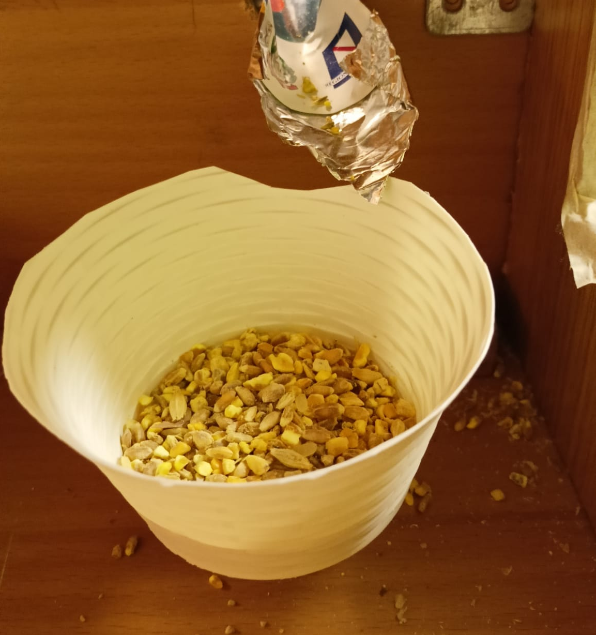
FOOD SUPPLY
The ultrasound sensor HCSR04 reads the level of food present in the tank once every 10 minutes. This sensor is controlled by a custom driver written in C using the Zerynth OS API. A load cell, located inside the hub, measures the weight of the food inside the food bowl. The load cell and the MCU interact using the ADC for weigh scales HX711, controlled by a custom driver in C. When the weight falls under a certain threshold, a servo motor drives the refill system.

Slide 6
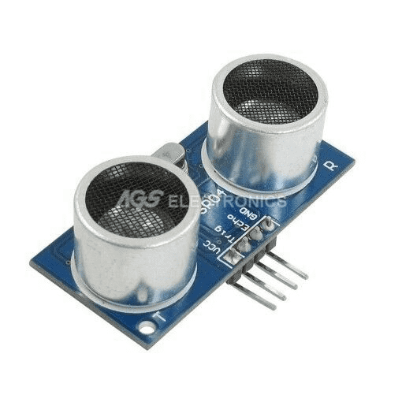
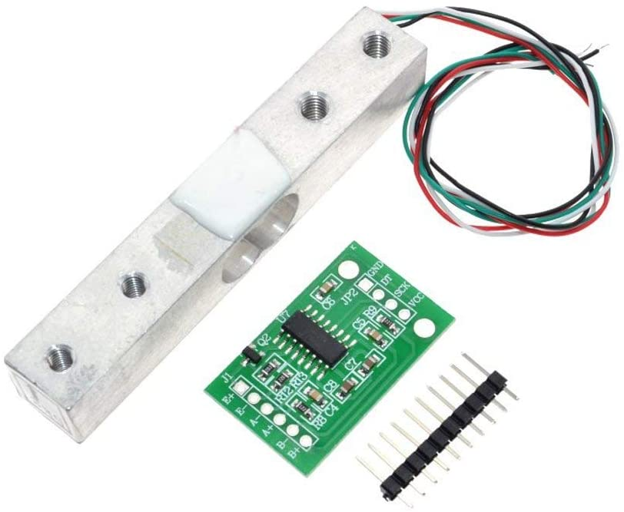
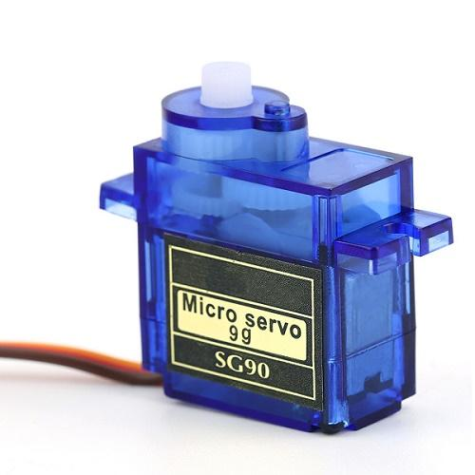
COMPONENTS
HCSR04
Ultrasound sensor
Load cell and HX711 ADC
Servomotor
SG90

Slide 7
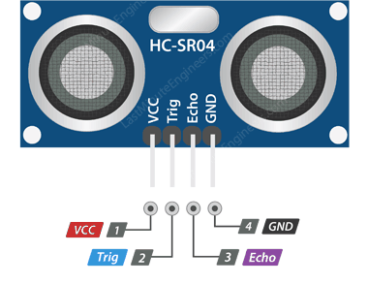
HCSR04 SENSOR
The Ultrasound HCSR04 Sensor measures the distance from the nearest obstacle. An ultrasound sensor can be used as a level sensor by simply placing it on top of the tank, as it measures the distance between the top of the tank and the surface of the liquid or solid stored inside the tank.

Slide 8
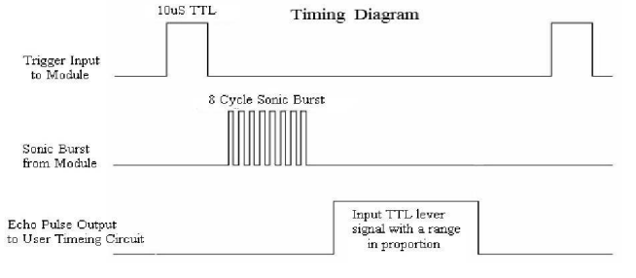
HCSR04 SENSOR TIMING
Source: HC-SR04 Datasheet
Notes:
Gugugaga

Slide 9
HCSR04 DRIVER
HCSR04 Sensor Timing
Driver logic
Firstly, a 10us pulse is sent to the trigger input, in order to request a measurement.
Afterwards, the module will send out a 40 kHz ultrasound 8 cycle burst.
Finally, the module sends a pulse on the echo pin whose duration is proportional to the time taken to reach the obstacle and return to the module.
Firstly, the driver issues the measurement by sending the pulse on the trigger pin.
Subsequently, the driver waits for the rising edge of the echo pin and then after the falling edge is detected the pulse duration is calculated by a difference between the two instants.
The driver returns this calculation, and this allows for a simple conversion in order to obtain the needed distance.

Slide 10
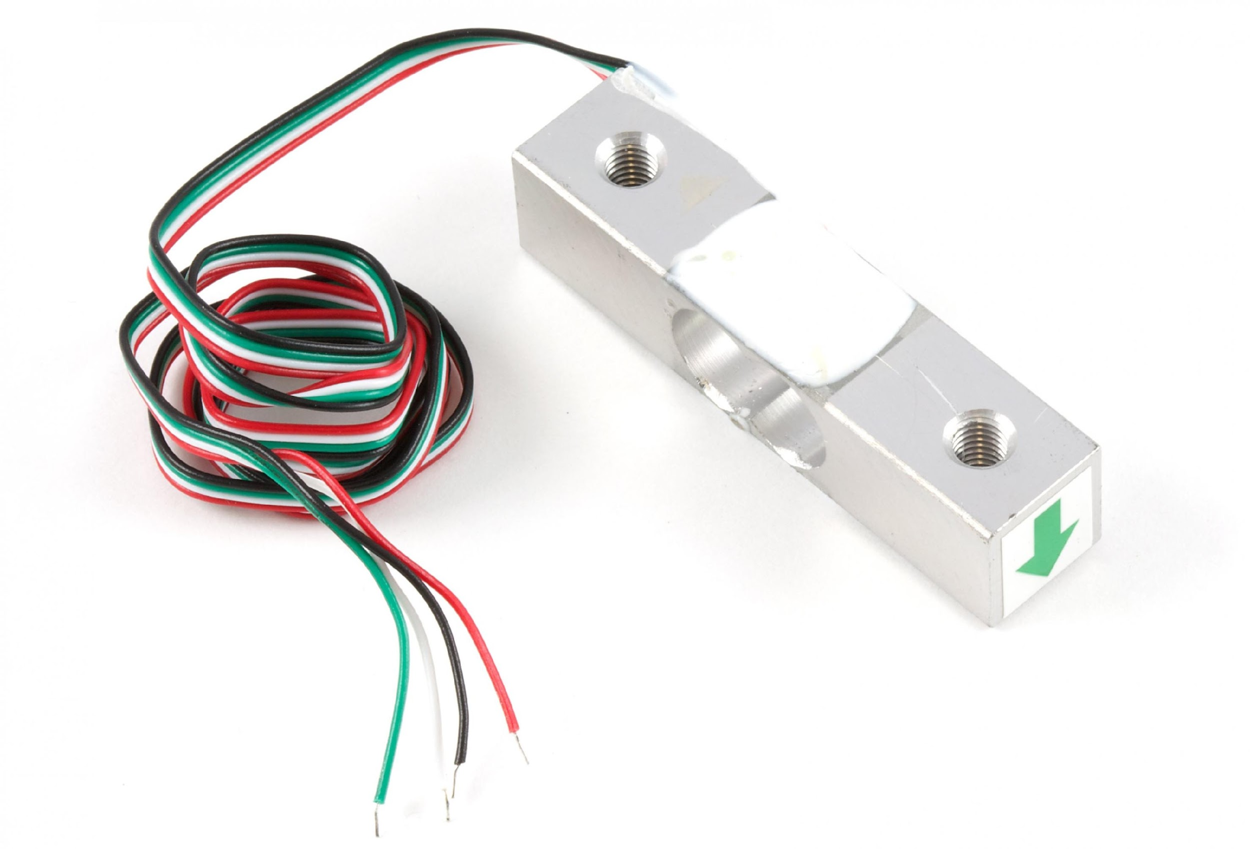
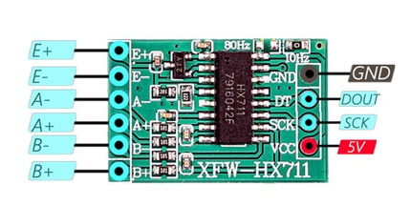
LOAD CELL
Load cells are capable of measuring the force applied on the sensor, that is why they are often used as scales. A load cell is composed of a strain gauge and a measurement circuit based on the Wheatstone Bridge. By supplying a small current to the loadcell, the measurement circuit outputs a small voltage. This voltages is read by the HX711 ADC for weighing scales.

Slide 11
LOAD CELL FUNCTIONING
1
2
3
Tare
Calibration
Measure
After placing a known weight on the load cell, a scale parameter is determined.
In order to tare the sensor, an offset parameter needs to be set.
After tare and calibration, the load cell is ready to weigh the scale.

Slide 12
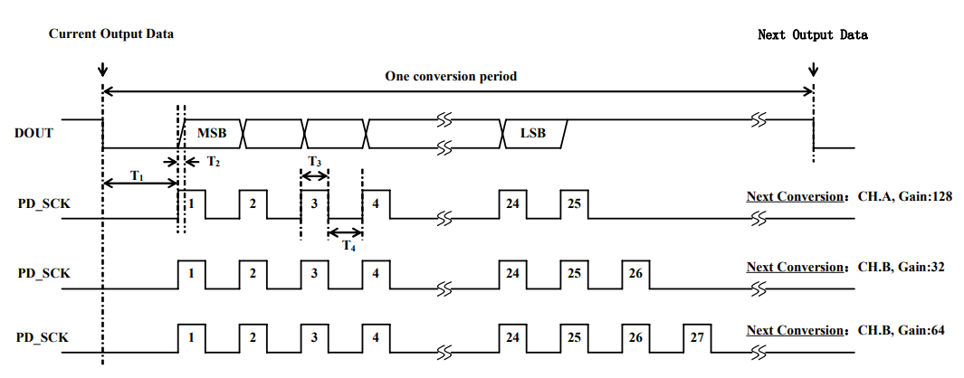
HX711 SERIAL PROTOCOL
Source: HX711 Datasheet

Slide 13
HX711 DRIVER
HX711 Serial Protocol
Driver logic
When the sensor is ready for data retrieval the DT pin is pulled low.
In order to request a single bit on the data input, a pulse on the SCK (clock) pin is needed. The bit is sent on the rising edge of the clock pulse. The HX711 module works in MSBFIRST mode.
After 24 cycles the reading is complete and the next clock pulses determine the sensor’s internal amplifier gain.
Firstly, the driver waits until the DT pin is pulled low.
Afterwards, the driver requests a single bit by sending a pulse on the SCK pin and then reads the bit value on the DT pin. This bit is stored into a three-byte long buffer. This reading is repeated 24 times.
Finally, the driver sends a certain number of pulses depending on the chosen gain.

Slide 14
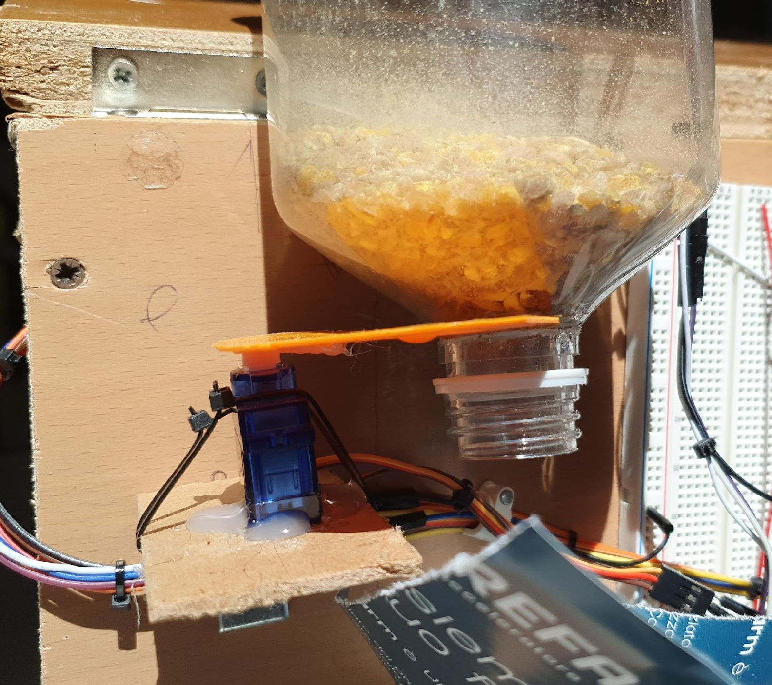
SERVOMOTOR
The Micro Servo SG90 is used as a «valve». It opens and closes so that a small portion of food gets poured on the bowl. This servomotor is controlled using the PWM technique. The PWM encodes an absolute position of the shaft and it allows a rotation of about 180 degrees.

Slide 15
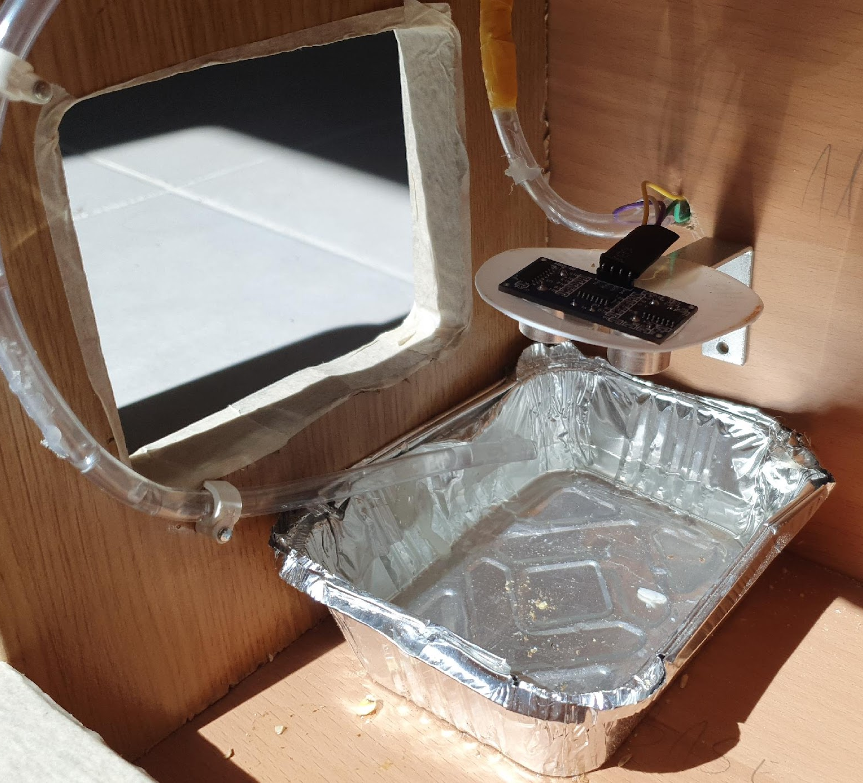
WATER SUPPLY
The ultrsound sensor HCSR04 reads the level of water present in the tank once every 10 minutes. Again, this sensor is controlled by the same custom driver written in C. Another HCSR04 measures the level of water inside the water bowl. When the water level falls under a certain threshold, the MCU activates the hydraulic pump.

Slide 16
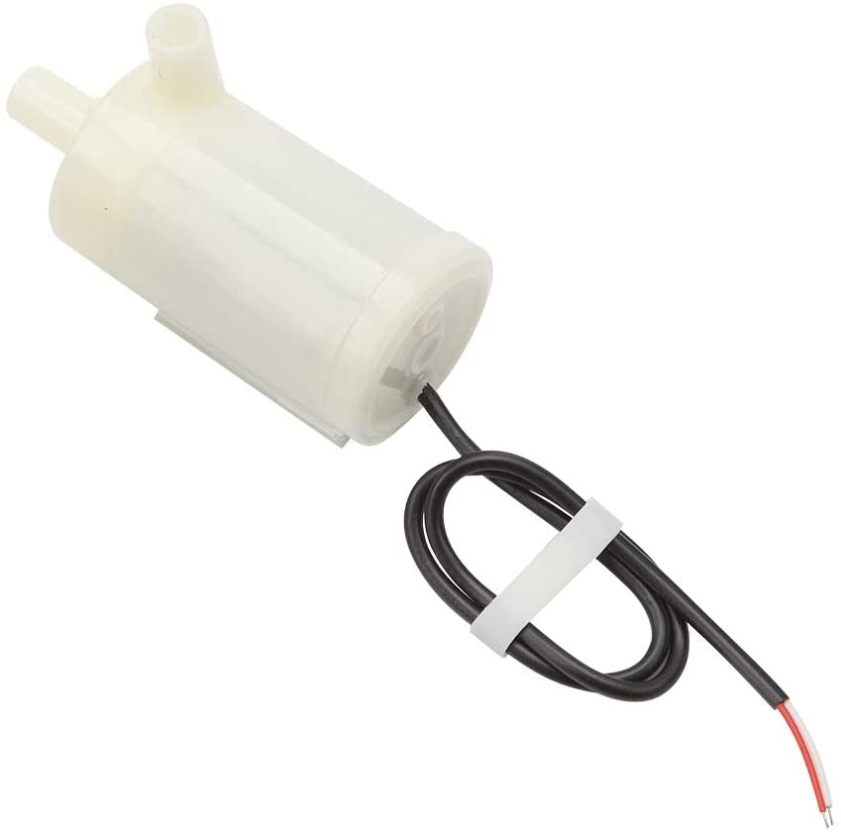
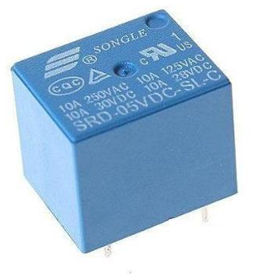
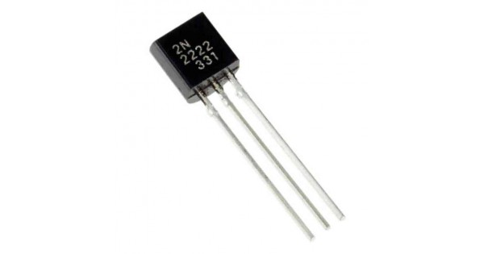
COMPONENTS
Hydraulic Pump
3.3V
HCSR04
Ultrasound sensor
Pump
interfacing circuit

Slide 17
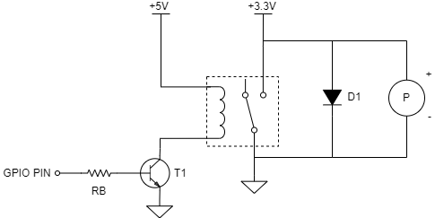
HYDRAULIC PUMP INTERFACING CIRCUIT
The hydraulic pump needs too much power in order to function properly, thus requiring the usage of an external power source. The pump has a rated voltage of 3.3VDC and a 5VDC relay is used to decouple the pump circuit from the MCU. In order to prevent flyback damage, a 1N4007 diode is used. Finally, since the pull-in voltage of the relay is 5VDC but the GPIO pins output ranges varies between 0 and 3,3 V, a PN222A BJT (common collector) is used as a current amplifier.

Slide 18
BIRD DETECTION SYSTEM

Slide 19
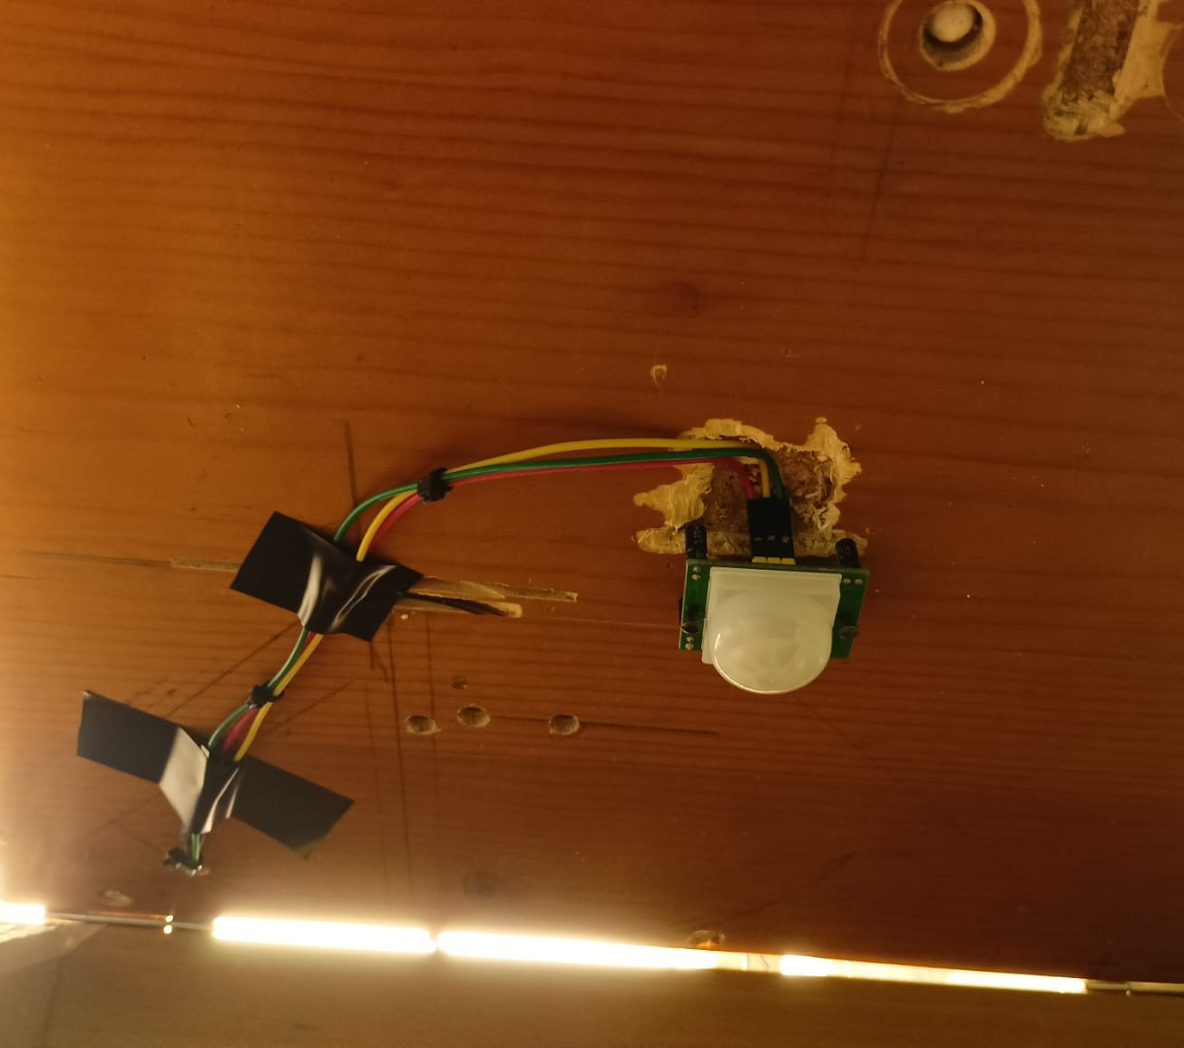
BIRD DETECTION
A PIR sensor is capable of detecting movement inside the hub. The PIR sensor is placed under the roof of the hub so that external movements are ignored. When a movement is detected, a JPEG photo is taken using the SPI Arducam camera. The MCU then sends the photo to a webserver via an HTTP POST request. The webserver then saves and displays the last picture received.

Slide 20
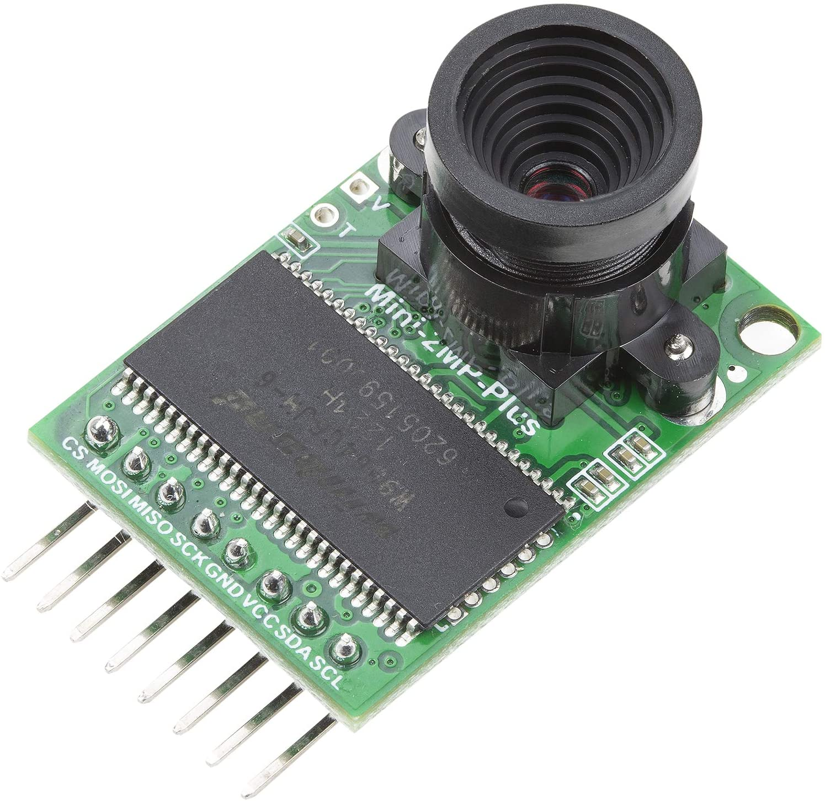
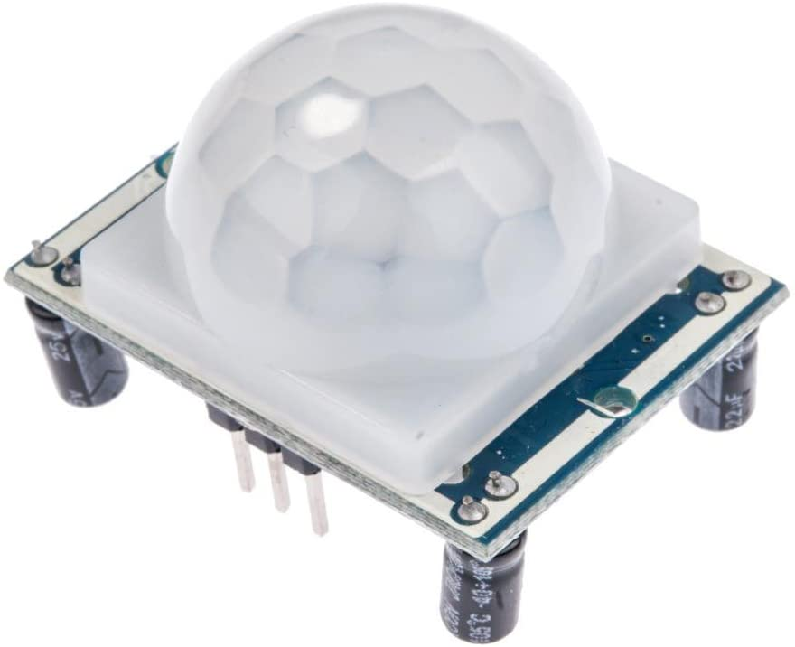
COMPONENTS
Arducam Mini
2MP PLUS
PIR
Motion Sensor

Slide 21
ARDUCAM
The Arducam Mini 2MP-Plus is a small camera equipped with both SPI and I2C interfaces. The I2C interface is used to communicate with the OV2640 Image Sensor, while the SPI interface is used to control the camera, issuing commands such as taking photos and reading the photo from the image buffer.

Slide 22
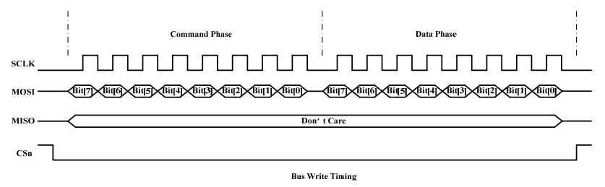
SPI INTERFACE TIMING

Slide 23
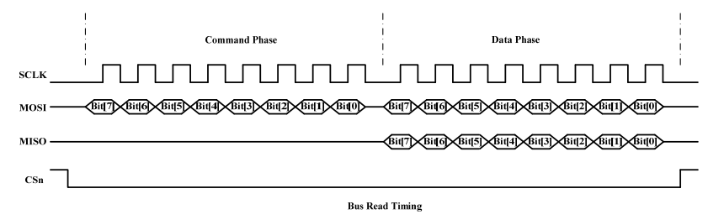
SPI INTERFACE TIMING

Slide 24
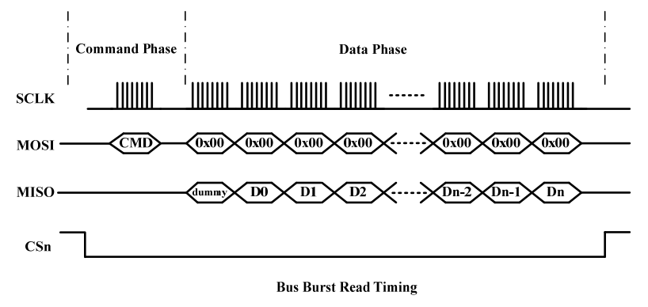
SPI INTERFACE TIMING

Slide 25
ARDUCAM SPI DRIVER
Register write
Register read
FIFO Buffer Read
In order to write on a register, the MCU needs to send on the MOSI line the register’s address followed by the actual data.
In order to read from a register, the MCU needs to send on the MOSI line the register’s address followed by an 8 bit dummy sequence. The slave responds on the MISO line with the register’s content.
In order to read from the FIFO buffer, the MCU needs to send the burst read command (0x3C) followed by dummy data (0x00) on the MOSI line. The slave will send the data after the first dummy byte on the MISO line.

Slide 26
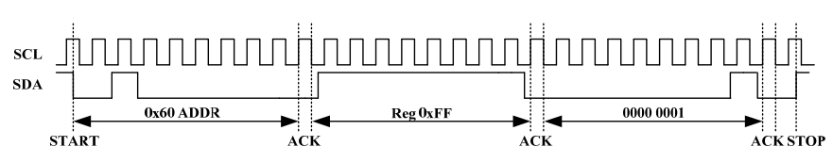
I2C INTERFACE TIMING
Write Bus Timing
In order to write into a OV2640’s register, the MCU needs to send on the SDA bus the slave address (0x30) followed by a zero bit, which encodes the writing command. After receiving the ACK from the slave, the MCU sends on the SDA bus the targeted register address. Finally, the slave sends the ACK bit and then the MCU transmits the register contents.

Slide 27
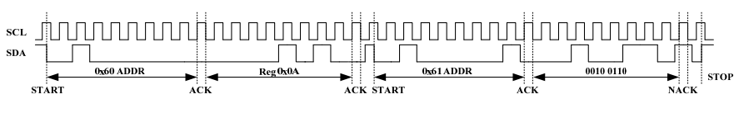
I2C INTERFACE TIMING
Read Bus Timing
In order to read from a OV2640’s register, the MCU needs to send on the SDA bus the slave address (0x30) followed by a zero bit, which encodes the writing command. After receiving the ACK from the slave, the MCU sends on the SDA bus the targeted register address. Afterwards, the MCU sends on the SDA bus the slave address (0x30) followed by a one bit which encodes the reading command. Finally, the slave responds with an ACK bit followed by the register contents.

Slide 28
PIR SENSOR
The PIR sensor is a sensor capable of detecting movement. It has a single data pin (OUT) which is pulled high in case of a detection. Readings from this sensor are quite unstable because, after the first detection, the OUT pin continues swinging for a few seconds. A small algorithm was needed in order to correct this behavior.

Slide 29
REMOTE CONTROL AND DASHBOARDING

Slide 30
«INTERNET» FEATURES
WEB SERVER
PHOTOS
DASHBOARDING
A small webserver written in Flask handles HTTP requests from the Arducam and MQTT messages.
The MCU can’t display the photo taken by Arducam in an understandable format. Image data are sent via HTTP to our webserver.
The level of water and food inside the tanks is monitored using the Zerynth dashboarding system. An alert is triggered when the level falls under a chosen threshold.

Slide 31

FLASK
Flask is a Python framework used to develop web applications. The Flask server uses the MQTT Paho Python library to send MQTT messages to the Mosquitto Broker. The webpage allows remote control of Birdhub, using a series of buttons and forms linked to endpoints.

Slide 32
«MQTT» ENDPOINTS
/tare
/replenish/<supply>
Sends a MQTT message on the topic birdhub/loadCell/tare.
Sends a MQTT message on the topic birdhub/replenish with supply payload. Supply can be either water or food.
/calibrate
/setPumpTime/<time>
Sends a MQTT message on the topic birdhub/loadCell/calibrate.
Sends a MQTT message on the topic birdhub/parameters with time payload. Time is a floating point number greater than 1000.
/takePhoto
/setAngle/<angle>
Sends a MQTT message on the topic birdhub/cam/takePhoto.
Sends a MQTT message on the topic birdhub/parameters with angle payload.
Angle is an integer number.

Slide 33
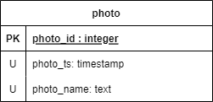
PHOTO MANAGEMENT
After the Arducam takes a picture, the image data is sent to the Flask server using an HTTP POST request to the endpoint /cam.
When the server receives this request, it writes the image data on a file. Photo’s names and their metadata (timestamp) are stored into a table called photo, managed by a SQLITE3 database connected to Flask.
The format of a new picture’s name is bird00X.jpg where X is the new picture id plus one.

Slide 34
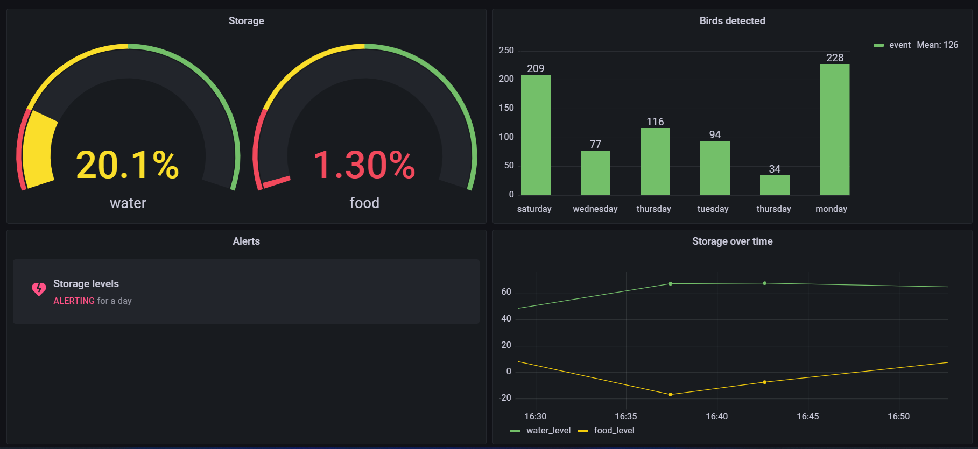
ZERYNTH DASHBOARD

Slide 35
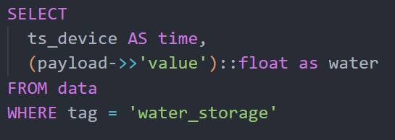
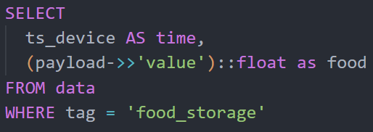
DASHBOARD QUERIES: STORAGE

Slide 36
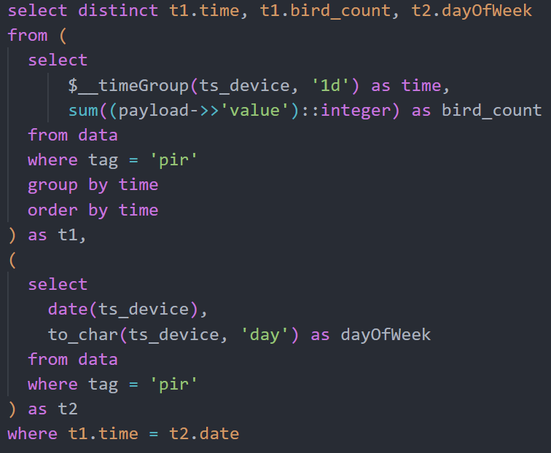
DASHBOARD QUERIES: HISTOGRAM
In this case nested queries were used to determine the day of week relative to each day.

Slide 37
PROBLEMS
SPI Conflict
Python drivers
When the Arducam camera was attached to SPI0 port of Zerynth (corresponding to ESP32’s SPI2 port), Zerynth SDK wasn’t able to load the code in ZM1’s memory.
When writing drivers in Python for timing critical operations, such as measuring pulses time of the HCSR04 sensor, the sleep function didn’t guarantee an accurate timing.
PIR Instability
Interfacing Pump Motor
The PIR sensor’s output was very unstable after detecting movement.
When the pump was connected to a BJT transistor in common collector configuration, the current supplied by the transistor wasn’t enough to power on the pump.

Slide 38
SOLUTIONS
SPI Conflict
The SPI conflict was solved by changing the SPI port from SPI0 to SPI1, which was not listed in the Zerynth ZM1-Eva Pinout. Source.
PIR Instability
After observing that the output stabilized after more than 5 seconds, a small algorithm was introduced to ascertain that the movement was really ended.
Python drivers
Drivers for sensors which required timing critical operations were written in C
Interfacing Pump Motor
A 5V relay was required to supply enough power to activate the pump.

Slide 39
THANKS
Group 09
Amendola Miriam
Battipaglia Valerio
Caso Antonio

